Slide 1

Nursing process

Slide 2
Learning Outcomes
Describe the significance of developing critical-thinking abilities in order to practice safe, effective, and professional nursing care.
Explore ways of demonstrating critical thinking in clinical practice.

Slide 3
Learning Outcomes (cont’d)
Discuss the skills and attitudes of critical thinking.
Discuss the relationships among critical thinking, the problem-solving process, and the decision-making process.

Slide 4
Critical Thinking
An intentional higher level reasoning process
Essential component of professional accountability and quality nursing care
Generated from professional, socioeconomic, and ethical/moral needs

Slide 5
Critical Thinking (cont’d)
Uses clinical reasoning and clinical decision making
  to practice safe and effective nursing care
  to improve clinical systems
  to decrease errors in clinical judgment

Slide 6
Critical Thinking Skills
Analyzing
Applying standards
Discriminating
Information seeking
Logical reasoning
Predicting
Transforming knowledge

Slide 7
Techniques in Critical Thinking
Critical analysis
Socratic questioning:
e.g. Why do you say that?’, ‘Could you explain further?’
Why do you say that?’, ‘Is there reason to doubt this evidence?’
Inductive reasoning,
deductive reasoning
Making valid inferences
Differentiating facts from opinions

Slide 8
Techniques in Critical Thinking (cont’d)
Evaluating the credibility of information sources
Clarifying concepts
Recognizing assumptions

Slide 9
Attitudes that Foster Critical Thinking
Independence
Fair-mindedness
Insight into self
Intellectual humility
Intellectual courage
استقلال
عادل الأفق
نظرة ثاقبة النفس
التواضع الفكري
الشجاعة الفكرية

Slide 10
Attitudes that Foster Critical Thinking (cont'd)
Integrity
Perseverance
Confidence
Curiosity
سلامة
مثابرة
الثقة
فضول

Slide 11
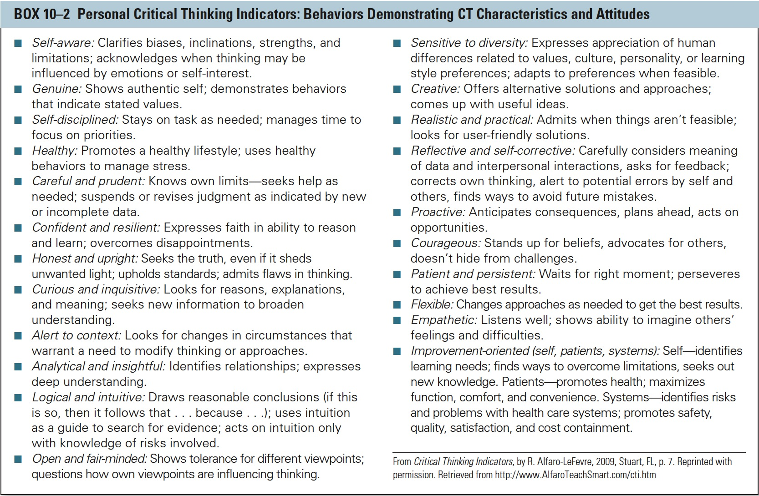
Box 10-2 Personal Critical Thinking Indicators: Behaviors Demonstrating CT Characteristics and Attitudes
Notes:
11

Slide 12
Critical Thinking and Nursing
Critical thinking underlies each step of the nursing process, problem-solving process, and decision-making process

Slide 13
The Nursing Process
Systematic, rational method of planning and providing individualized care
  Assessing
  Diagnosing
  Planning
  Implementing
  Evaluating

Slide 14
Problem-Solving Process
Clarify the nature of a problem and suggest possible solutions
Commonly used approaches
  Trial and error
  Intuition
  Research process

Slide 15
Decision-Making Process
Choosing the best actions to meet a desired goal
  Value decisions (e.g., keeping client information confidential)
  Time management decisions (e.g., take clean linens in at the same time as giving medications)

Slide 16
Decision-Making Process (cont'd)
Choosing the best actions to meet a desired goal
  Scheduling decisions (e.g., bathing clients before visiting hours)
  Prioritizing decisions (e.g., most urgent ones and ones that can be delegated)

Slide 17
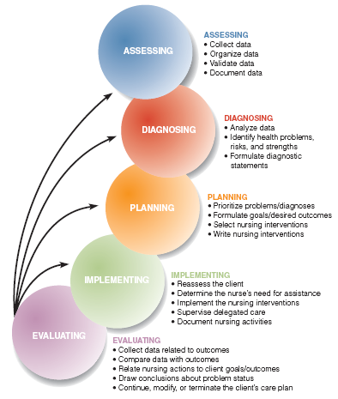
The Nursing Process
Copyright 2008 by Pearson Education, Inc.
Notes:
17
Figure 11-1 The nursing process in action.

Slide 18
Assessing
Copyright 2008 by Pearson Education, Inc.
Collecting data
Organizing data
Validating is the act of “double-checking” or verifying data to confirm that it is accurate and factual.
Documenting data
Goal
  Establish a database about the client’s response to health concerns or illness
Notes:
18

Slide 19
Diagnosing
Copyright 2008 by Pearson Education, Inc.
Analyzing and synthesizing data
Goals
  Identify client strengths
  Identify health problems that can be prevented or resolved
  Develop a list of nursing and collaborative problems
Notes:
19

Slide 20
Planning
Determining how to prevent, reduce, or resolve identified priority client problems
Determining how to support client strengths
Determining how to implement nursing interventions in an organized, individualized, and goal-directed manner
Goals
  Develop an individualized care plan that specifies client goals/desired outcomes
  Related nursing interventions
Copyright 2008 by Pearson Education, Inc.
Notes:
20

Slide 21
Implementing
Carrying out (or delegating) and documenting planned nursing interventions
Goals
  Assist the client to meet desired goals/outcomes
  Promote wellness
  Prevent illness and disease
  Restore health
  Facilitate coping with altered functioning
Copyright 2008 by Pearson Education, Inc.
Notes:
21

Slide 22
Evaluating
Copyright 2008 by Pearson Education, Inc.
Measuring the degree to which goals/outcomes have been achieved
Identifying factors that positively or negatively influence goal achievement
Goal
  Determine whether to continue, modify, or terminate the plan of care
Notes:
22

Slide 23
Characteristics of the
Nursing Process
Copyright 2008 by Pearson Education, Inc.
Cyclic and dynamic nature
Client centeredness
Focus on problem-solving and decision-making
Interpersonal and collaborative style
Universal applicability
Use of critical thinking
Notes:
23

Slide 24
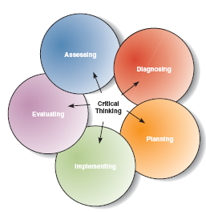
Characteristics of the
Nursing Process
Copyright 2008 by Pearson Education, Inc.
Notes:
24

Slide 25
Types of Assessments
Initial
  Performed within a specified time period
  Establishes complete database
Problem-Focused
  Ongoing process integrated with care
  Determines status of a specific problem
Emergency
  Performed during physiologic or psychologic crises
  Identifies life-threatening problems
  Identifies new or overlooked problems
Time-lapsed
  Occurs several months after initial
  Compares current status to baseline
Notes:
25

Slide 26
Initial assessment: is performed within a specified time after admission to a health care agency for the purpose of establishing a complete database for problem identification, reference, and future comparison.
Problem-focused assessment : is an ongoing process integrated with nursing care to determine the status of a specific problem identified in an earlier assessment.

Slide 27
Emergency assessment: occurs during any physiologic or psychologic crisis of the client to identify the life-threatening problems and to identify new or overlooked problems.
Time-lapsed (expired) reassessment: occurs several months after the initial assessment to compare the client’s current status to baseline data previously obtained.

Slide 28
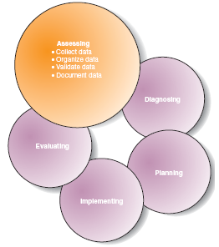
Assessment Activities
Collecting data
Organizing data
Validating data
Documenting data
Notes:
28

Slide 29
Collecting data is the process of gathering information about a client’s health status.
Organizing data is categorizing data systematically using a specified format.
Validating data is the act of “double-checking” or verifying data to confirm that it is accurate and factual.
Documenting is accurately and factually recording data.

Slide 30
Subjective Data
Copyright 2008 by Pearson Education, Inc.
Symptoms or covert data
Apparent only to the person affected
Can be described only by person affected
Includes sensations, feelings, values, beliefs, attitudes, and perception of personal health status and life situations
Notes:
30

Slide 31
Objective Data
Copyright 2008 by Pearson Education, Inc.
Signs or overt data
Detectable by an observer
Can be measured or tested against an accepted standard
Can be seen, heard, felt, or smelled
Obtained through observation or physical examination
Notes:
31

Slide 32
Sources of Data
Copyright 2008 by Pearson Education, Inc.
Primary Source
  The client
Secondary Sources
  All other sources of data
  Should be validated, if possible
Notes:
32

Slide 33
Methods of Data Collection
Observing
  Gathering data using the senses
  Used to obtain following types of data:
    Skin color (vision)
    Body or breath odors (smell)
    Lung or heart sounds (hearing)
    Skin temperature (touch)
Copyright 2008 by Pearson Education, Inc.
Notes:
33

Slide 34
Methods of Data Collection
Copyright 2008 by Pearson Education, Inc.
Interviewing
  Planned communication or a conversation with a purpose
  Used to:
    Identify problems of mutual concern
    Evaluate change
    Teach
    Provide support
    Provide counseling or therapy
Notes:
34

Slide 35
Methods of Data Collection
Examining (physical examination)
  Systematic data-collection method
  Uses observation and inspection, auscultation, palpation, and percussion
    Blood pressure
    Pulses
    Heart and lungs sounds
    Skin temperature and moisture
    Muscle strength
Copyright 2008 by Pearson Education, Inc.
Notes:
35

Slide 36
Closed and Open-ended Questions
Closed Question
Restrictive
  Yes/no
  Factual (accurate)
Less effort and information from client
“What medications did you take?”
“Are you having pain now?”
Open-ended Question
Specify broad topic to discuss
Invite longer answers
Get more information from client
Useful to change topics and elicit attitudes
“How have you been feeling lately?”
Copyright 2008 by Pearson Education, Inc.
Notes:
36

Slide 37
Nursing diagnosis
North American Nursing Diagnosis Association (NANDA)
A nursing diagnosis is a clinical judgment about individual, family, or community experiences and responses to actual or potential health problems and life processes.

Slide 38
NURSING DIAGNOSIS VS. MEDICAL DIAGNOSIS
A medical diagnosis deals with disease or medical condition.
A nursing diagnosis deals with human response to actual or potential health problems and life processes.
For example:
  a medical diagnosis of Cerebrovascular Attack (CVA or Stroke) provides information about the patient’s pathology.
  The complimentary nursing diagnoses of Impaired verbal communication, risk for falls, interrupted family processes and powerlessness

Slide 39
Nursing Diagnosis
Types of Nursing Diagnosis
  Actual
  Risk
  Wellness
  Possible
  Syndrome

Slide 40
Actual Diagnosis
Problem present at the time of the assessment
Presence of associated signs and symptoms
    (ineffective breathing pattern)

Slide 41
Risk Diagnosis
  Problem does not exist
  Presence of risk factors
    (High risk for complication)

Slide 42
Wellness Diagnosis
Readiness for enhancement
describes human responses to levels of wellness in an individual, family, or community that have a readiness enhancement.”
  (readiness for enhanced spiritual well-being or readiness for enhanced family coping)

Slide 43
Possible Diagnosis
  Evidence about a health problem incomplete or unclear
  Requires more data to either support or to refute it
  Example:(possible social isolation)

Slide 44
Syndrome Diagnosis
  Associated with a cluster of other diagnoses.

Slide 45
Components of a Nursing Diagnosis
  Problem
  Etiology
  Defining characteristics

Slide 46
Problem Statement (Diagnostic Label)
  Describes the client’s health problem or response

Slide 47
Etiology (Related Factors and Risk Factors)
  Identifies one or more probable causes of the health problem

Slide 48
Defining Characteristics
Cluster of signs and symptoms indicating the presence of a particular diagnostic label (actual diagnoses)
Factors that cause the client to be more vulnerable to the problem (risk diagnoses)

Slide 49
Steps in Diagnostic Process
Analyzing data
  Compare data against standards
  Cluster cues
  Identify gaps and inconsistencies
Identifying health problems, risks, and strengths
Formulating diagnostic statements

Slide 50
Formats for Writing Nursing Diagnoses
Basic two-part statement
  Problem (P)
  Etiology (E)

Slide 51
Basic three-part statement
  Problem (P)
  Etiology (E)
  Signs and symptoms (S)
  Example:
  Ineffective airway clearance RT accumulation of secretions in the lung AMB crackles and difficulty in breathing (slow and shallow breathing)

Slide 52
One-part statement
  Wellness (readiness for enhanced)

Slide 53
Variations
Unknown etiology
Complex factors
Possible
Secondary
Other additions for precisions

Slide 54
Writing unknown etiology when the defining characteristics are present but the nurse does not know the cause or contributing factors
Using the phrase complex factors when there are too many etiologic factors or when they are too complex to state in a brief phrase

Slide 55
Using the word possible to describe either the problem or the etiology when the nurse believes more data are needed about the client’s problem or the etiology

Slide 56
Using secondary to divide the etiology into two parts, thereby making the statement more descriptive and useful (the part following secondary to is often a pathophysiologic or disease process or a medical diagnosis)
Adding a second part to the general response or NANDA label to make it more precise

Slide 57
Guidelines for writing nursing diagnosis statements:
Write statements in terms of a problem instead of a need.
Word the statement so that it is legally advisable.
Use nonjudgmental statements.
Be sure both elements of the statement do not say the same thing.

Slide 59
Be sure cause and effect are stated correctly.
Word diagnosis specifically and precisely.
Use nursing terminology rather than medical terminology to describe the client’s response.
Using nursing terminology rather than medical terminology to describe the probable cause of the client’s response.

Slide 60
To improve diagnostic reasoning and avoid diagnostic reasoning errors
Verify diagnoses by talking with the client and family
Build a good knowledge base and acquire clinical experience.
Have a working knowledge of what is normal.
Consult resources
Improve critical-thinking skills.

Slide 61
Advantages of a Taxonomy of Nursing Diagnoses
Development of a standardized nursing language
Nursing minimum data set

Slide 62
Taxonomy is the practice and science of categorization and classification.
The NANDA-I taxonomy currently includes 206 nursing diagnoses that are grouped (classified) within 13 domains (categories) of nursing practice: Health Promotion; Nutrition; Elimination and Exchange; Activity/Rest; Perception/Cognition; Self-Perception; Role Relationships; Sexuality; Coping/Stress Tolerance; Life Principles; Safety/Protection; Comfort; Growth/Development

Slide 63
Planning
Prioritizing problems/diagnoses
Formulating client goals/desired outcomes
Identifying activities in the planning Process
Selecting nursing interventions
Writing individualized nursing interventions

Slide 64
Guidelines for Writing Nursing Care Plans
Date and sign the plan
Use category headings
Use standardized/approved terminology and symbols
Be specific
Refer to other sources
Individualize the plan to the client
Incorporate prevention and health maintenance
Include discharge and home care plans

Slide 65
Identify factors that the nurse must consider when setting priorities.
Establishing a preferential sequence for addressing nursing diagnoses and interventions
  High priority (life-threatening)
  Medium priority (health-threatening)
  Low priority (developmental needs)

Slide 66
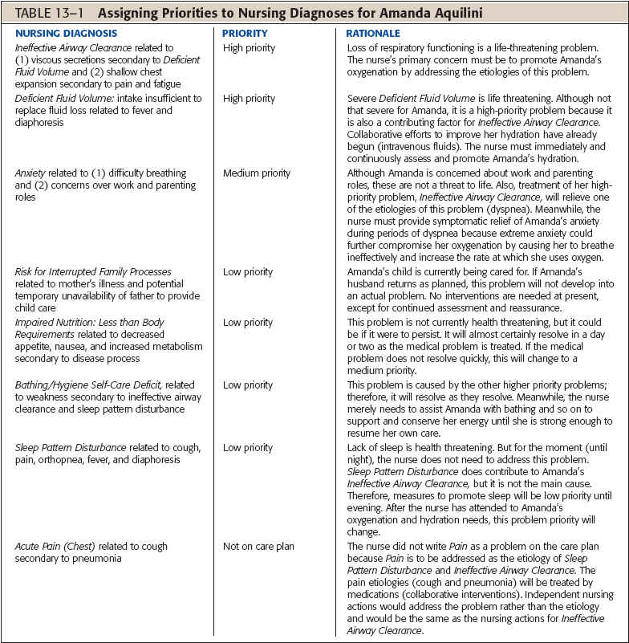

Slide 67
Factors to Consider When Setting Priorities
Urgency of the health problem
Client’s health values and beliefs
Resources available to the nurse and client
Medical treatment plan

Slide 68
Describe the relationship of goals/desired outcomes to the nursing diagnoses.
Goals derived from diagnostic label
Diagnostic label contains the unhealthy response (problem)
Goal/desired outcome demonstrates resolution of the unhealthy response (problem)

Slide 69
Guidelines for writing goals/desired outcomes
Components of Goal/Desired Outcome Statements
Subject
Verb
Condition
Criterion of desired performance

Slide 71
Guidelines for Writing Goal/Outcome Statements
Write in terms of the client responses
Must be realistic
Ensure compatibility with the therapies of other professionals
Derive from only one nursing diagnosis
Use observable, measurable terms

Slide 73
Nursing Intervention
Actions nurse performs to achieve goals/desired outcomes
Focus on eliminating or reducing etiology of nursing diagnosis
Treat signs/symptoms and defining characteristics

Slide 74
Types of Nursing Interventions
Direct
Indirect
Independent interventions
Dependent interventions
Collaborative interventions

Slide 75
Direct care is an intervention performed through interaction with the client.
Indirect care is an intervention performed away from but on behalf of the client such as management of the care environment.

Slide 76
independent interventions, those activities that nurses are licensed to initiate on the basis of their knowledge and skills;
dependent interventions, activities carried out under the primary care provider’s orders or supervision, or according to specified routines;
collaborative interventions, actions the nurse carries out in collaboration with other health team members. The nurse must choose interventions that are most likely to achieve the goal/desired outcome.

Slide 77
Criteria for Choosing Appropriate Intervention
Safe and appropriate for the client’s age, health, and condition
Achievable with the resources available
Congruent with the client’s values, beliefs, and culture
Congruent with other therapies
Based on nursing knowledge and experience or knowledge from relevant sciences
Within established standards of care

Slide 78
The process of implementing phase
  Reassessing the client
  Determining the nurse’s need for assistance
  Implementing nursing interventions
  Supervising delegated care
  Documenting nursing activities

Slide 79
Evaluation
Evaluating is a planned, ongoing, purposeful activity in which clients and health care professionals determine the client’s progress toward achievement of goals/ outcomes and the effectiveness of the nursing care plan.

Slide 80
Difference between assessment and evaluation
During the assessment phase the nurse collects data for the purpose of making diagnoses.
During the evaluation step the nurse collects data for the purpose of comparing the data to preselected goals and judging the effectiveness of the nursing care.
The act of assessing (data collection) is the same. The differences lie in when the data are collected and how the data are used.

Slide 81
Components of the Evaluation Process
Collecting data related to the desired outcomes
( nursing outcomes classifications NOC indicators)
Comparing the data with outcomes
Relating nursing activities to outcomes
Drawing conclusions about problem status
Continuing, modifying, or terminating the nursing care plan

Slide 82
Questions
The nurse selects the nursing diagnosis of Risk for Impaired Skin Integrity related to immobility, dry skin, and surgical incision. Which of the following represents a properly stated outcome/goal? The client will:
Turn in bed q2h.
Report the importance of applying lotion to skin daily.
Have healthy intact skin during hospitalization.
Use a pressure-reducing mattress.

Slide 83
3 is Correct. The goal or outcome should state the opposite of the nursing diagnosis stem, and thus healthy intact skin is the reverse condition of impaired skin integrity.

Slide 84
The nurse assesses a post-operative client with an abdominal wound and finds the client drowsy when not aroused, the client’s pain is ranked 2 on a scale of 0 to 10, vital signs (VS) are within preoperative range, extremities are warm with good pulses but very dry skin, declines oral fluids due to nausea, reports no bowel movement in the past 2 days, hip dressing is dry with drains intact. Which of the following elements is most likely to be considered of high priority for a change in the current care plan?
Pain
Nausea
Constipation
Potential for wound infection

Slide 85
2 is Correct. A more detailed assessment data and consultation with the client would be needed to absolutely confirm the priority. Postoperative nausea to the level of inhibiting oral intake has the greatest likelihood of leading to complications and requires nursing intervention now.

Slide 86
Which of the following elements is best categorized as secondary subjective data?
The nurse measures a weight loss of 10 pounds since the last clinic visit.
Spouse states the client has lost all appetite.
The nurse palpates edema in lower extremities.
Client states severe pain when walking up stairs.

Slide 87
2 is Correct. Secondary data comes from any other source (chart, family) besides the client. Subjective data are covert (reported or an opinion).

Slide 88
In the diagnostic statement “Excess fluid volume related to decreased venous return as manifested by lower extremity edema (swelling),” the etiology of the problem is which of the following?
Excess fluid volume.
Decreased venous return.
Edema.
Unknown.

Slide 89
2 is Correct. Because the venous return is impaired, fluid is static, resulting in swelling. Therefore, decreased venous return is the cause (etiology) of the problem.

Slide 90
Which of the following nursing diagnoses contains the proper components?
Risk for caregiver role strain related to unpredictable illness course.
Risk for falls related to tendency to collapse when having difficulty breathing.
Decreased communication related to stroke.
Sleep deprivation secondary to fatigue and a noisy environment.

Slide 91
1 is Correct. States the relationship between the stem (caregiver role strain) and the cause of the problem.

Slide 92
The client has a high-priority nursing diagnosis of Risk for Impaired Skin Integrity related to the need for several weeks of imposed bed rest. The nurse evaluates the client after 1 week and finds the skin integrity is not impaired. When the care plan is reviewed, the nurse should perform which of the following?
Delete the diagnosis since the problem has not occurred.
Keep the diagnosis since the risk factors are still present.
Modify the nursing diagnosis to Impaired Mobility.
Demote the nursing diagnosis to a lower priority.

Slide 93
2 is Correct. The risk factors are still present so the diagnosis is still valid.

Slide 94
The nurse in charge identifies a patient's responses to actual or potential health problems during which step of the nursing process?
A. Assessing
B. Diagnosing
C. Planning
D. Evaluating

Slide 95
A female patient is diagnosed with deep-vein thrombosis. Which nursing diagnosis should receive the highest priority at this time?
A. Impaired gas exchange related to increased blood flow
B. Fluid volume excess related to peripheral vascular disease
C. Risk for injury related to edema
D. Altered peripheral tissue perfusion related to venous congestion

Slide 96
A nurse is revising a client's care plan. During which step of the nursing process does such a revision take place?
A. Assessment
B. Planning
C. Implementation
D. Evaluation

Slide 97
Which intervention should the nurse in charge try first for a client that exhibits signs of sleep disturbance?
A. Administer sleeping medication before bedtime
B. Ask the client each morning to describe the quantity of sleep the night before
C. Teach the client relaxation techniques, such as guided imagery and progressive muscle relaxation
D. Provide the client normal sleep aids, such as pillows, back rubs, and snacks

Slide 98
Using Maslow's hierarchy of needs, a nurse assigns the highest priority to which client need?
A. Elimination
B. Security
C. Safety
D. Belonging

Slide 99
When two nursing diagnoses appear closely related, what should the nurse do first to determine which diagnosis most accurately reflects the needs of a patient?
A. Reassess the patient
B. Examine the related to factors
C. Analyze the secondary to factors
D. Review the defining characteristics

Slide 100
The nurse performs an assessment of a newly admitted patient. The nurse understands that this admission assessment is conducted primarily to:
A. Diagnose if the patient is at risk for falls.
B. Ensure that the patient's skin is intact
C. Establish a therapeutic relationship
D. Identify important data

Slide 101
The guidelines for writing an appropriate nursing diagnosis include all of the following except:
A. State the diagnosis in terms of a problem, not a need
B. Use nursing terminology to describe the patient's response
C. Use statements that assist in planning independent nursing interventions
D. Use medical terminology to describe the probable cause of the patient's response

Slide 102
Independent nursing interventions commonly used for patients with pressure ulcers include:
A. changing the patient's position regularly to minimize pressure
B. Applying a drying agent such as an antacid to decrease moisture at the ulcer site
C. Debriding the ulcer to remove necrotic tissue, which can impede healing
D. Placing the patient in a whirlpool bath containing povidone-iodine solution as tolerated

Slide 103
While the nurse is providing a patient personal hygiene, she observes that his skin is excessively dry. During the procedure, he tells her that he is very thirsty. An appropriate nursing diagnosis would be:
A. Potential for impaired skin integrity R/T altered gland function
B. Potential for impaired skin integrity R/T dehydration
C. Impaired skin integrity R/T dehydration
D. Impaired skin integrity R/T altered circulation

Slide 104
Thank you

